Slide 1
C# Workshop
Absolute Basics of Programming
Maciej Wyrodek

Slide 2
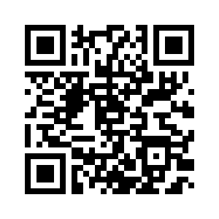
Slides and Materials:
https://github.com/mwyrodek/testcamp_workshop

Slide 3
Agenda
1.Intro
2. Visual Studio and its functions
3. data tapes, variables
4. Methods
5. If statements
6. Loops

Slide 4
What are your goals?
What do you want to learn?

Slide 5
What is programming?

Slide 6
Why do Testers need to know how to code?

Slide 7
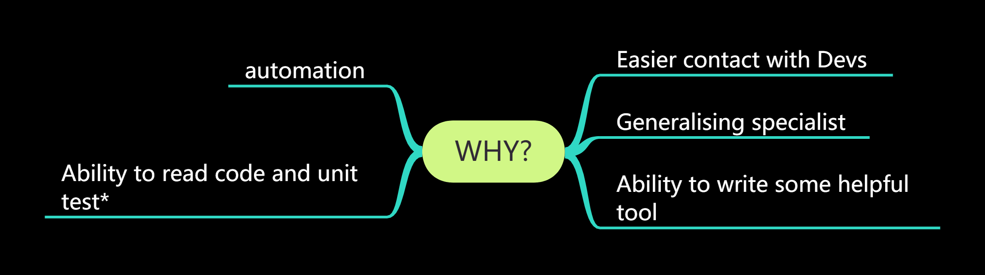

Slide 8
YOU NEED A MENTOR!

Slide 9
YOU NEED A MENTOR!
1 day is not enough to learn

Slide 10
What I will help you with:
I will get you enough knowledge to start.
I will point you where to find more info.
I will point you where to start.
I will help you get some practice

Slide 11
Open VS!

Slide 12
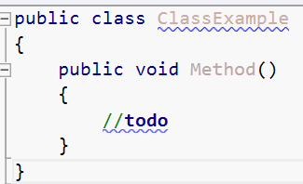

Slide 13
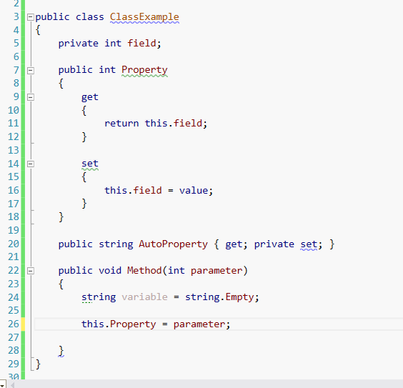

Slide 14
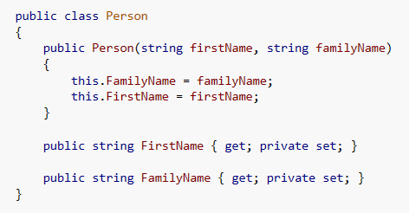

Slide 15
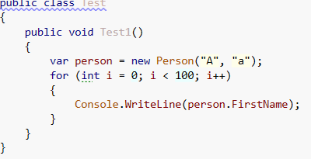
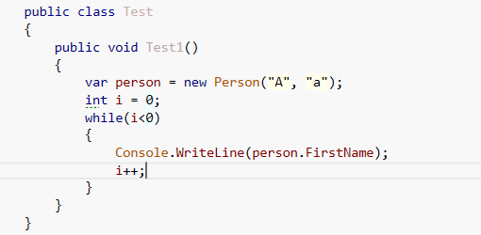

Slide 16
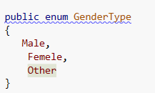
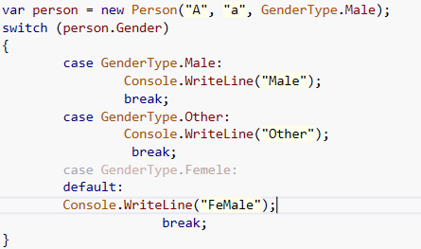
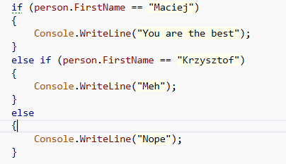

Slide 17
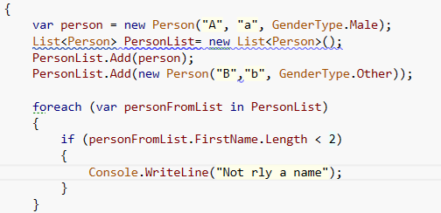

Slide 18
Materials you can use

Slide 19
What I will help you with:
Computer Science Fundamentals:
https://online-learning.harvard.edu/course/cs50-introduction-computer-science
Wstęp do programowania w C#, Anna Kempa, Tomasz Staś
http://c-sharp.ue.katowice.pl
C#. Praktyczny kurs. Wydanie III, Marcin Lis, wyd.3, wyd. Helion
C#. Ćwiczenia. Wydanie IV, Marcin Lis, wyd. Helion
Channel9 online courses
Classe sand methods description at MSDN: http://msdn.microsoft.com/pl-pl/library/system.net(v=vs.110).aspx
docs.microsoft.com
msdn.com

Slide 20
Thank You!
https://thebrokentest.com/

